Slide 1
Summary discussion
Top-down approach
Consider Carbon Monitoring Systems, tailored to address stakeholder needs.
CMS frameworks can be designed to provide products as inputs for a stakeholder, e.g., methane inventories in California, deforestation rates in Brazil.
Noted that there are local to international stakeholders, e.g., UNFCC, Indonesia, but few if any global stakeholders—possible exception of IPCC.
CMS could play a role as independent evaluation that account for relevant scientific processes, e.g. role of lateral carbon transport (rivers) to regional carbon balance.
  These processes may not be accounted for in standard protocols but impact the larger objective, e.g., carbon sequestration
CMS could play a role in assessing the combined effectiveness of multiple stakeholder objectives within a changing climate, e.g., REDD, Blue Carbon, energy efficiency, agricultural practices in a region?
Moving forward
  Engage with CMS scientists on current stakeholder needs, e.g., Duren’s and Brown’s activities
  Assess how CMS could evolve to meet those needs
    Are those needs already addressed by existing capabilities, e.g., Sonoma County biomass?
    Are there aspects missing that a broader framework could address.
  Investigate how CMS could address broader issues relevant but not explicitly needed by stakeholders

Slide 2
MRV (&V) - what problem(s) are we solving?
Mitigation Policies & Programs
(UNFCCC CDM, REDD+, Emission Trading Systems, etc)
Measurement, Reporting & Verification (MRV) frameworks
Project-level forest carbon data
Carbon Registries
GHG inventories & reporting
(e.g., EPA)
Facility-level reporting
Aggregated Source/Sink fluxes (F) by sector
Continuous Emission Monitoring or Calculation
*surface physical manifestations of energy use (e.g., nightlights, urban form, etc)
F = A * EF
Activity (A) data and statistics (e.g., EIA, FIA)
Emission factors (EF) databases
Validation
Earth Observations
Land Carbon Stocks & Fluxes
Energy Activity*
Atmospheric Carbon
Ocean Carbon

Slide 3
Bottom-up approach
Identified a number of cases where complimentary CMS projects could seed potential frameworks through collaborative activity
  Use of multiple land-surface estimates to provide sensitivity of riverine carbon export to upstream carbon
  multiple global boundary conditions to regional atmospheric inversion studies
Moving forward
  Use survey questions to see which projects could potentially collaborate with others
    CO₂ Boundary conditions from CMS-Flux (Bowman) and GEOS-CARB (Ott) to regional inverse modeling, e.g., Andrews
    Sensitivity of soil carbon riverine transport to upstream carbon storage (Lorenz, Collatz)
  Make recommendations of “frameworks-of-opportunity” where possible

Slide 4
Top-down approach: moving forward

Slide 5
Carbon Monitoring sys·tem
ˈsistəm/
noun
1. a set of connected things or parts forming a complex whole, in particular.
a set of things working together as parts of a mechanism or an interconnecting network
2. a set of principles or procedures according to which something is done; an organized scheme or method.

Slide 6
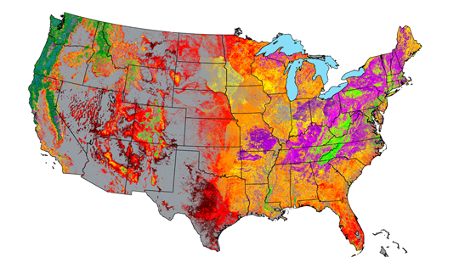
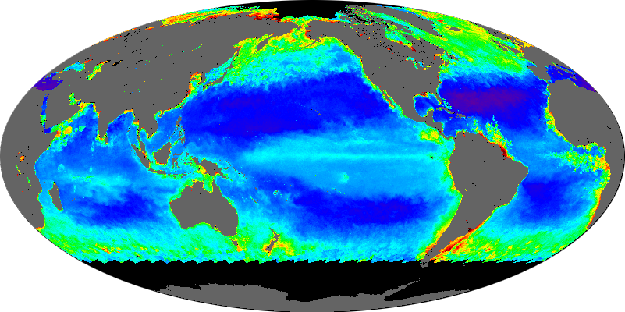
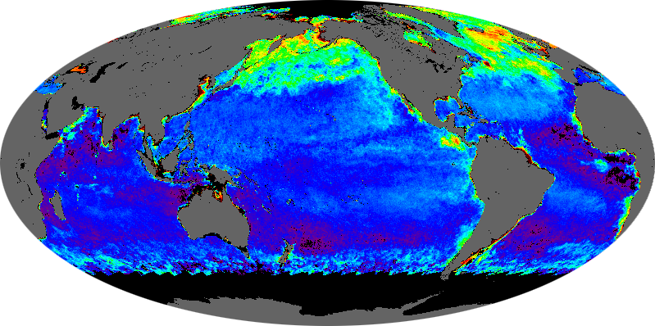
NASA-CMS Phase 1 Examples
Notes:
Biomass National Pilot- Saatchi et al. 250m biomass map.
Biomass Local- Cook, Dubayah, Hurtt et al. 90m biomass map and c sequestration estimates for 2 counties in MD.
Flux-Pawson et al., system diagram
Oceans- Behrenfeld et al. Study to address link between chi and b

Slide 7

Gridded Mass Balance
One pool,
Multiple fluxes (j)
ΔStock=Σ(Flux_{j})
e.g. Global atmospheric
Carbon budget
Multiple pools (i),
Mulitple fluxes (j)
ΔStock_{i}=Σ(Flux_{i,j})
e.g. atmoshere, land,
Ocean, etc.
Multiple pools (i),
Multiple fluxes (j),
Gridded (k)
ΔStock_{i,k}=Σ(Flux_{i,j,k})
e.g. Potential NASA-CMS
-> Overlay relevant NASA products
And uncertainties
-> i.d. capabilities, strengths, gaps
-> match/optimize to user needs

Slide 8







NASA-CMS Phase 2
Award year: # of projects (decision support / MRV)
2012: 20
2013: 17
Global Surface-Atmosphere Flux
2012: 2
Land-Atmosphere Flux
2012: 6 (5/1)
2013: 8 (6/4)
Ocean-Atmosphere Flux
2012: 1
Land Biomass
2012: 7 (5/2)
2013: 9 (9/8)
Ocean Biomass
2012: 3
Land-Ocean Flux
2012: 1

Slide 9
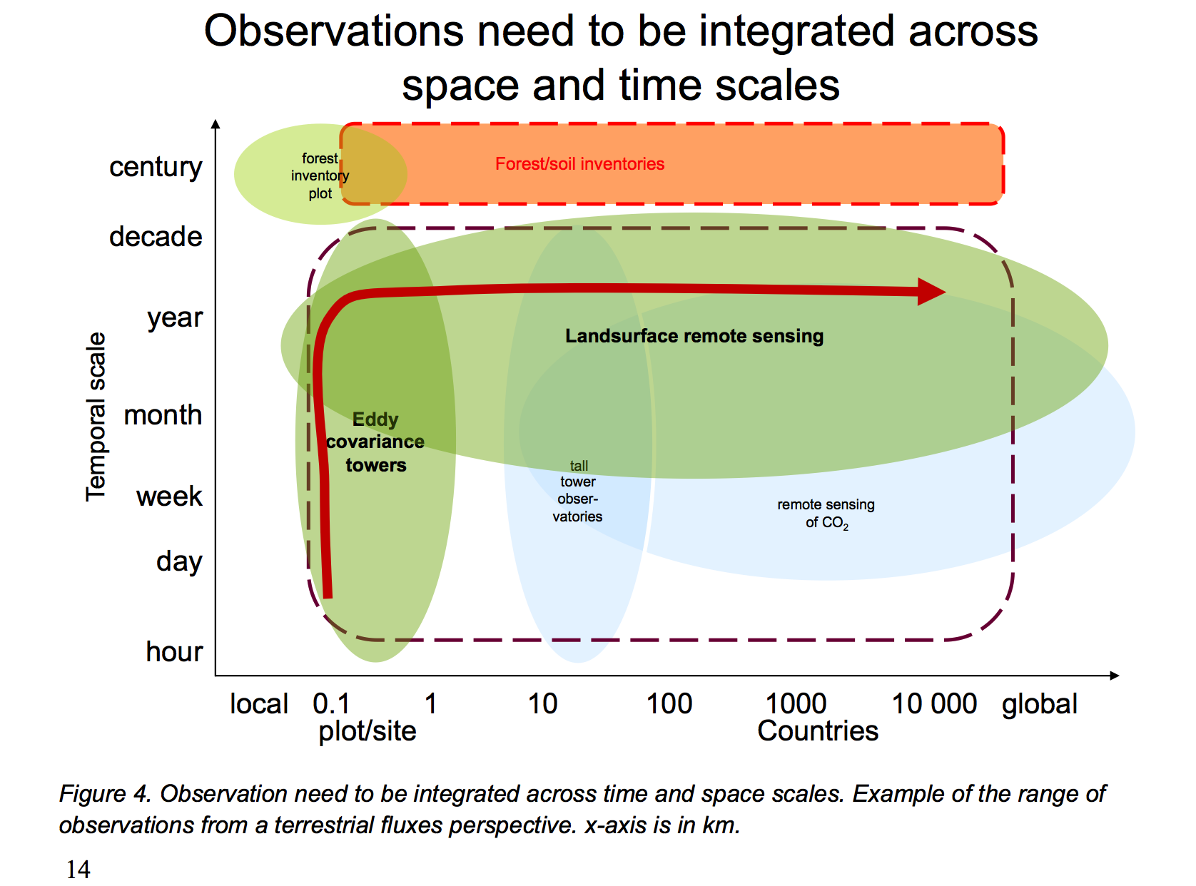
Observation scale
GEO-Carbon Strategy, 2010

Slide 10
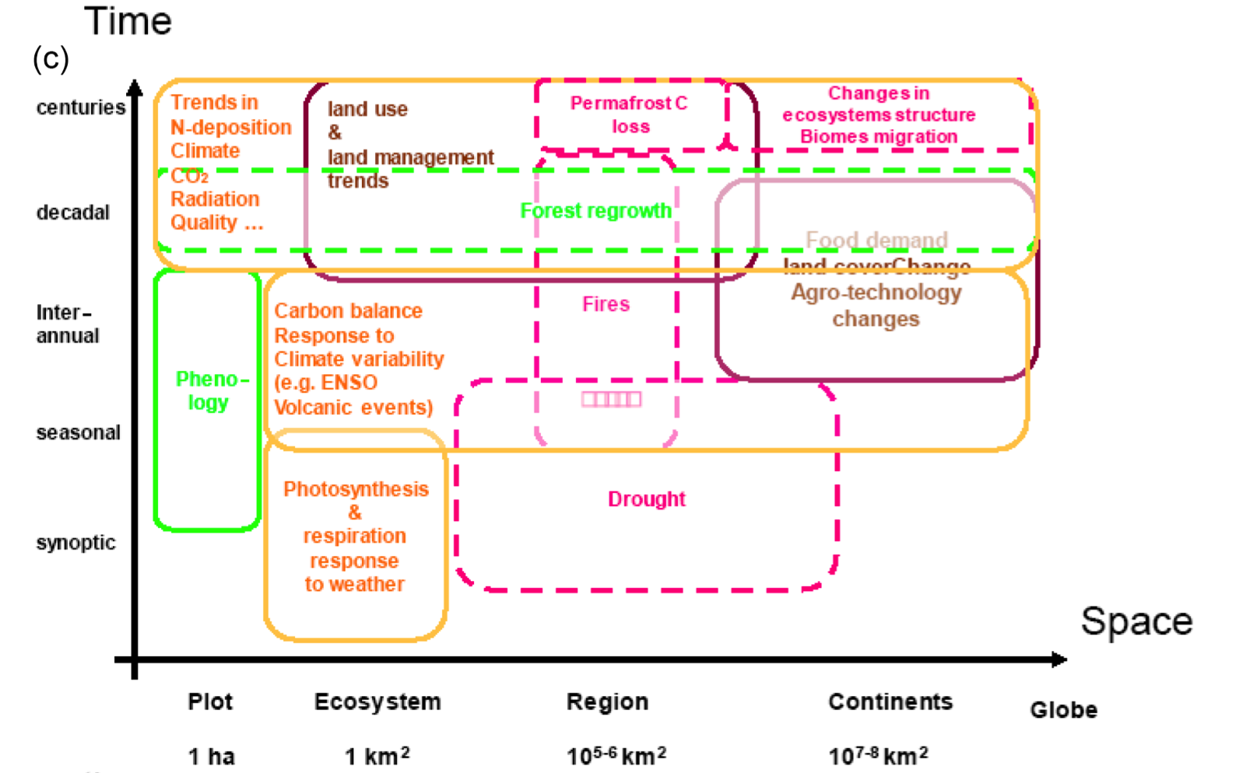
Process scale
Ciais et al, GBC, 2014

Slide 11
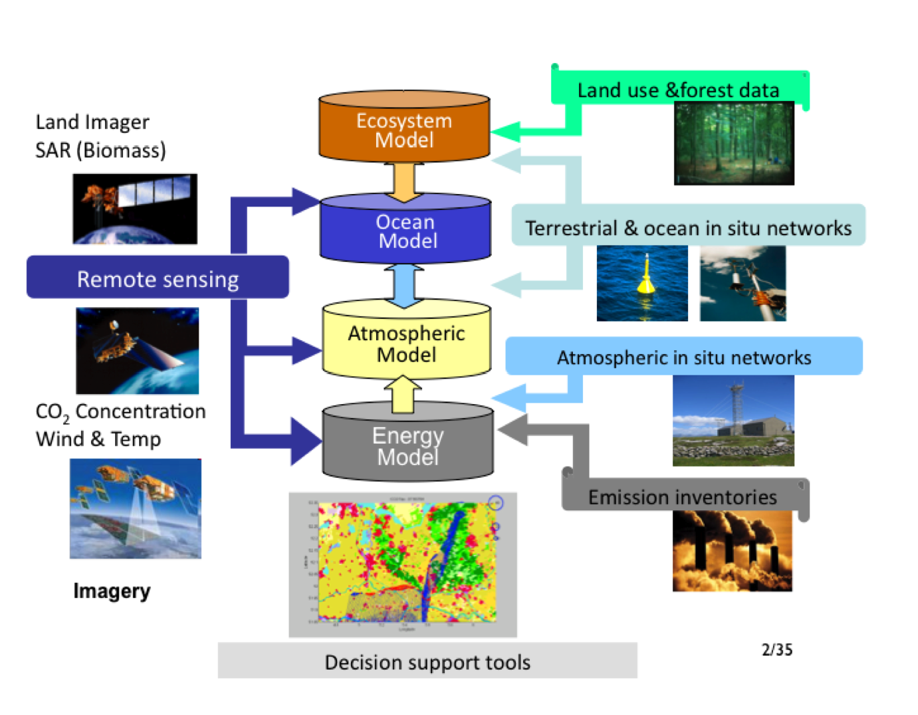
Integration
CMS activities (esp. GEO-CARB and CMS-Flux) have made activities have made significant advances in Carbon Cycle Data Assimilation Systems (CCDAS) recommended in the GEO-Carbon strategy.
CCDAS prefer consistent spatial
and temporal scales.
How to integrate across such diverse scales?
Do we need a multi-scale CCDAS?
GEO-Carbon Strategy, 2010

Slide 12
Towards a CMS: two approaches
“Bottom-up”
  Find “systems-of-opportunity” that build collaborations leveraging existing projects
  Find projects that are performing complimentary activities
“Top-down”
  Review national and international documents related to CMS, e.g., GEO-Carbon Strategy.
    Assess relevance to CMS
  Assess requirements from current and potential users
  Recommend steps to build CMS framework(s)

